Slide 1

Service of the Word
Worship will begin at 10:30am.
Please add your prayer concerns in the comment box.
Remember to mute your microphone.
WartburgSeminary.edu

Slide 2
WARTBURG THEOLOGICAL SEMINARY
Worship will begin at 10:30 am.
Service of the Word
All the materials you will need will be on the screen.
Add your prayer concerns in the chat window below.
A digital “Coffee Time” will be offered following the service.
We invite you to have an open Bible or something that conveys the Word of God to you near you, as well as a small candle.
Remember to mute yourself.
Notes:
Start this slide at 10:25am.

Slide 4

Gathering
The Holy Spirit calls us together as the people of God.

Slide 5
Thanksgiving for Baptism

Slide 6
Blessed be the holy Trinity, ☩ one God,
the fountain of living water,
the rock who gave us birth,
our light and our salvation.
Amen.

Slide 7
Joined to Christ in the waters of baptism,
we are clothed with God's mercy and forgiveness.
Let us give thanks for the gift of baptism.

Slide 8
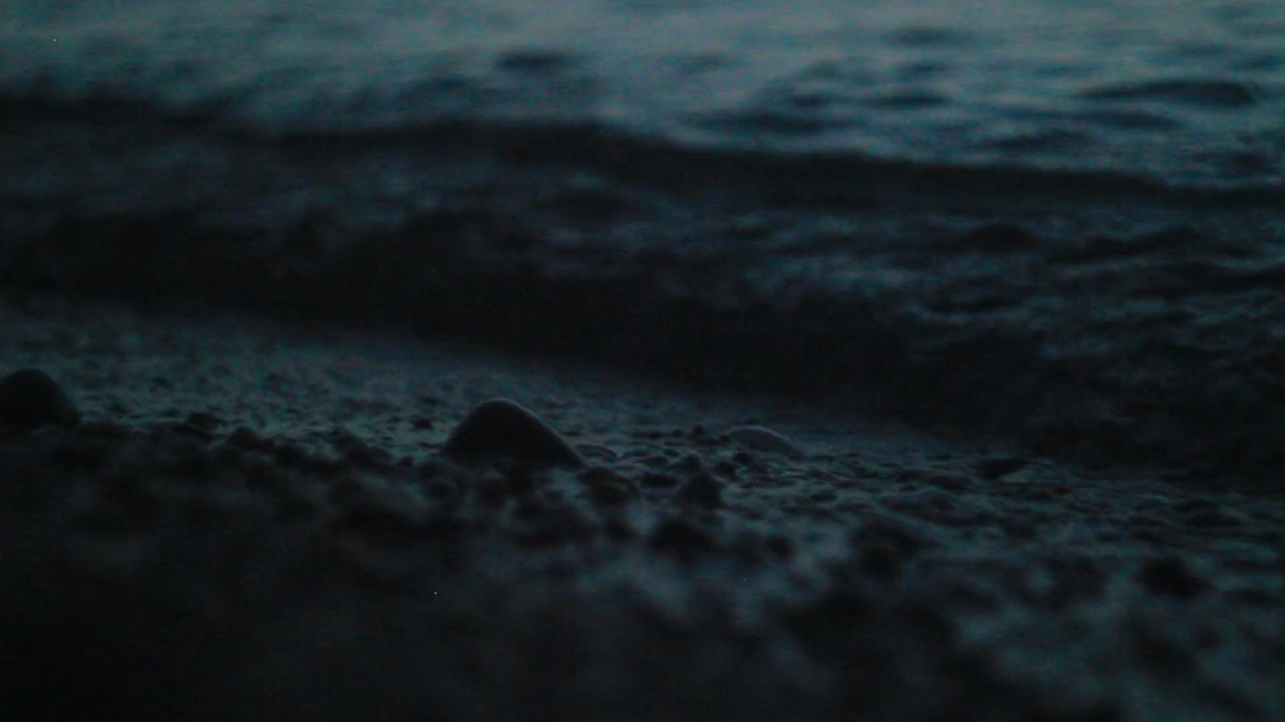

Slide 9
Light your small candle.
Kyrie – ELW page 213

Slide 10
Prayer of the Day
Let us pray,
Merciful God, the fountain of living water, you quench our thirst and wash away our sin. Give us this water always. Bring us to drink from the well that flows with the beauty of your truth through Jesus Christ, our Savior and Lord, who lives and reigns with you and the Holy Spirit, one God, now and forever.
Amen.

Slide 11
WORD
God speaks to us in scripture reading, preaching, and song.

Slide 12
Jeremiah 2:4-13

Slide 13
⁴ Hear the word of the Lord, O house of Jacob, and all the families of the house of Israel. ⁵ Thus says the Lord:
What wrong did your ancestors find in me that they went far from me, and went after worthless things, and became worthless themselves?
⁶ They did not say, “Where is the Lord who brought us up from the land of Egypt, who led us in the wilderness, in a land of deserts and pits, in a land of drought and deep darkness, in a land that no one passes through, where no one lives?”
⁷ I brought you into a plentiful land to eat its fruits and its good things.
But when you entered you defiled my land, and made my heritage an abomination.
⁸ The priests did not say, “Where is the Lord?”
Those who handle the law did not know me; the rulers^{[a]} transgressed against me; the prophets prophesied by Baal, and went after things that do not profit.

Slide 14
⁹ Therefore once more I accuse you, says the Lord, and I accuse your children’s children.
¹⁰ Cross to the coasts of Cyprus and look, send to Kedar and examine with care; see if there has ever been such a thing.
¹¹ Has a nation changed its gods, even though they are no gods?
But my people have changed their glory for something that does not profit.
¹² Be appalled, O heavens, at this, be shocked, be utterly desolate, says the Lord,
¹³ for my people have committed two evils: they have forsaken me, the fountain of living water, and dug out cisterns for themselves, cracked cisterns that can hold no water.

Slide 15
ELW Psalm 95
Come, let us sing to the Lord;
let us shout for joy to the rock of our salvation.
Let us come before God’s presence with thanksgiving
and raise a loud shout to the Lord with psalms.
For you, Lord, are a great God,
and a great ruler above all gods.
In your hand are the caverns of the earth;
the heights of the hills are also yours.
The sea is yours, for you made it,
and your hands have molded the dry land.
Come, let us worship and bow down,
let us kneel before the Lord our maker.

Slide 16
For the Lord is our God, and we are the people of
God’s pasture and the sheep of God’s hand.
Oh, that today you would hear God’s voice!
“Harden not your hearts,
as at Meribah, as on that day at Massah in the desert.
There your ancestors tested me,
they put me to the test, though they had seen my works.
Forty years I loathed that generation, saying,
‘The heart of this people goes astray; they do not know my ways.’
Indeed I swore in my anger,
‘They shall never come to my rest.’”

Slide 17
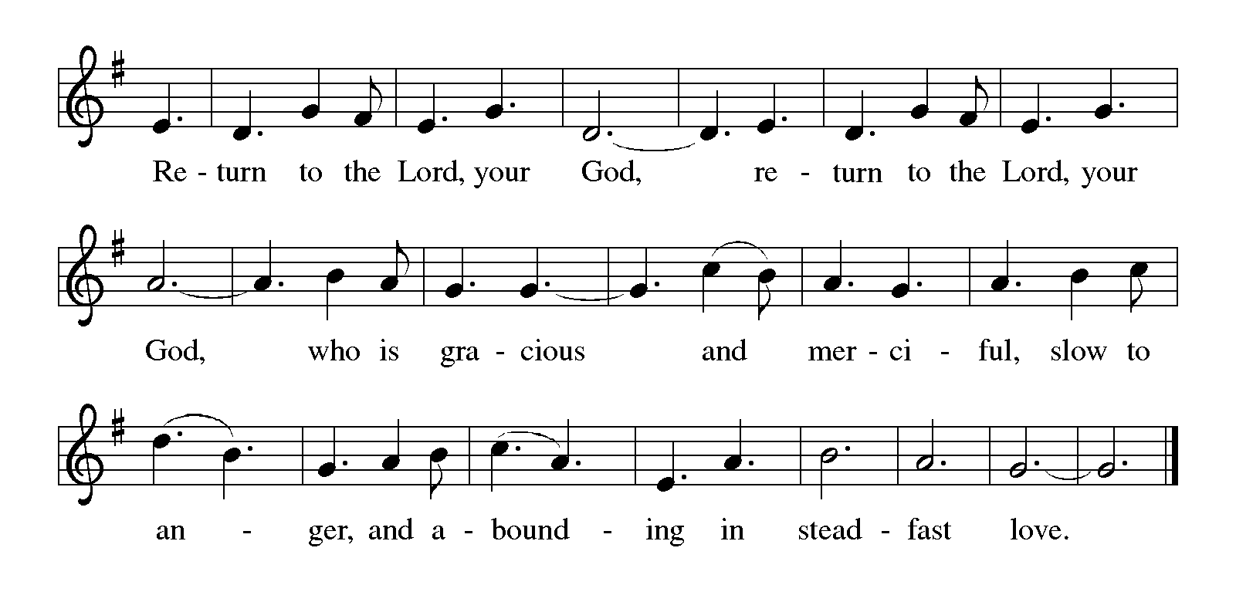
Gospel Acclamation – ELW page 216

Slide 18
John 7:14-31, 37-39
The holy gospel according to John, the 7th Chapter
Glory to you, O Lord

Slide 19
14 About the middle of the festival Jesus went up into the temple and began to teach. 15 The Jews were astonished at it, saying, “How does this man have such learning, when he has never been taught?” 16 Then Jesus answered them, “My teaching is not mine but his who sent me. 17 Anyone who resolves to do the will of God will know whether the teaching is from God or whether I am speaking on my own. 18 Those who speak on their own seek their own glory; but the one who seeks the glory of him who sent him is true, and there is nothing false in him.
19 “Did not Moses give you the law? Yet none of you keeps the law. Why are you looking for an opportunity to kill me?” 20 The crowd answered, “You have a demon! Who is trying to kill you?” 21 Jesus answered them, “I performed one work, and all of you are astonished. 22 Moses gave you circumcision (it is, of course, not from Moses, but from the patriarchs), and you circumcise a man on the sabbath. 23 If a man receives circumcision on the sabbath in order that the law of Moses may not be broken, are you angry with me because I healed a man’s whole body on the sabbath? 24 Do not judge by appearances, but judge with right judgment.”

Slide 20
²⁵ Now some of the people of Jerusalem were saying, “Is not this the man whom they are trying to kill? ²⁶ And here he is, speaking openly, but they say nothing to him! Can it be that the authorities really know that this is the Messiah?^{[b]} ²⁷ Yet we know where this man is from; but when the Messiah^{[c]} comes, no one will know where he is from.” ²⁸ Then Jesus cried out as he was teaching in the temple, “You know me, and you know where I am from. I have not come on my own. But the one who sent me is true, and you do not know him. ²⁹ I know him, because I am from him, and he sent me.” ³⁰ Then they tried to arrest him, but no one laid hands on him, because his hour had not yet come. ³¹ Yet many in the crowd believed in him and were saying, “When the Messiah^{[d]} comes, will he do more signs than this man has done?"
37 On the last day of the festival, the great day, while Jesus was standing there, he cried out, “Let anyone who is thirsty come to me, 38 and let the one who believes in me drink. As[a] the scripture has said, ‘Out of the believer’s heart[b] shall flow rivers of living water.’” 39 Now he said this about the Spirit, which believers in him were to receive; for as yet there was no Spirit,[c] because Jesus was not yet glorified.
The Gospel of the Lord.
Praise to you, O Christ

Slide 21
“Let anyone who is thirsty come to me, and let the one who believes in me drink. “

Slide 22

Silence for Reflection

Slide 23
SERMON
ELISABETH PYNN HIMMELMAN
ELW 637

Slide 24
Prayers for times of public health concern: COVID-19/Coronavirus

Slide 25
SERMON
ELISABETH PYNN HIMMELMAN
God, our peace and our strength, we pray for our nation and the world as we face new uncertainties around coronavirus. Protect the most vulnerable among us, especially all who are currently sick or in isolation. Grant wisdom, patience, and clarity to health care workers, especially as their work caring for others puts them at great risk. Guide us as we consider how best to prepare and respond in our families, congregations, workplaces, and communities. Give us courage to face these days not with fear but with compassion, concern, and acts of service, trusting that you abide with us always; through Jesus Christ our Lord.
Amen.
Gracious God, it is good for us to gather as your beloved in community. We treasure your presence with us in word and meal, song and prayer. Be with us in these days when gathering together as often as we would like is not possible. When we must be apart for reasons of safety, we trust that you surround us with your sheltering wings. Encourage us in connecting as we are able, reaching out to our neighbors in need and being persistent in prayer. We ask this in the name of Jesus, our constant companion.
Amen.

Slide 26
SERMON
ELISABETH PYNN HIMMELMAN
O God, where hearts are fearful and constricted, grant courage and hope. Where anxiety is infectious and widening, grant peace and reassurance. Where impossibilities close every door and window, grant imagination and resistance. Where distrust twists our thinking, grant healing and illumination. Where spirits are daunted and weakened, grant soaring wings and strengthened dreams. All these things we ask in the name of Jesus Christ, our Savior and Lord.
Amen.
God of the present moment,
God who in Jesus stills the storm
and soothes the frantic heart,
bring hope and courage to all who wait or work in uncertainty.
Bring hope that you will make them the equal of whatever lies ahead.
Bring them courage to endure what cannot be avoided,
for your will is health and wholeness;
you are God, and we need you.
Amen.

Slide 27
SERMON
ELISABETH PYNN HIMMELMAN
The Apostles' Creed
I believe in God, the Father almighty,
creator of heaven and earth,
I believe in Jesus Christ, God’s only son, our Lord
who was conceived by the Holy Spirit,
born of the virgin Mary,
suffered under Pontius Pilate,
was crucified, died, and was buried;
he descended to the dead.
On the third day he rose again;
he ascended into heaven,
he is seated at the right hand of the Father,
and he will come to judge the living and the dead
I believe in the Holy Spirit,
the holy catholic church,
the communion of saints,
the forgiveness of sins,
the resurrection of the body,
and the life everlasting. Amen.

Slide 28
Prayers
Lord in your mercy.
Hear our prayer.

Slide 29
Thanksgiving

Slide 30
SERMON
ELISABETH PYNN HIMMELMAN
Canticle of Thanksgiving – ELW page 219

Slide 31
SERMON
ELISABETH PYNN HIMMELMAN
Canticle of Thanksgiving – ELW page 219​

Slide 32
Thanksgiving for the Word

Slide 33
SERMON
ELISABETH PYNN HIMMELMAN
Let us pray.
Praise and thanks to you, holy God, for by your Word you made all things: you spoke light into darkness, called forth beauty from chaos, and brought life into being.
For your Word of life, O God, we give you thanks and praise.
By your Word you called your people Israel to tell of your wonderful gifts: freedom from captivity, water on the desert journey, a pathway home from exile, wisdom for life with you.
For your Word of life, O God, we give you thanks and praise.
Through Jesus, your Word made flesh, you speak to us and call us to witness: forgiveness through the cross, life to those entombed by death, the way of your self-giving love.
For your Word of life, O God, we give you thanks and praise.
Send your Spirit of truth, O God; rekindle your gifts within us: renew our faith, increase our hope, and deepen our love, for the sake of a world in need. Faithful to your Word, O God, draw near to all who call on you; through Jesus Christ, our Savior and Lord, to whom, with you and the Holy Spirit, be honor and glory forever.
Amen.

Slide 34
SERMON
ELISABETH PYNN HIMMELMAN
The Lord's Prayer
Our Father in heaven,
  hallowed be your name,
  your kingdom come,
  your will be done,
    on earth as in heaven.
Give us today our daily bread.
Forgive us our sins
  as we forgive those
    who sin against us.
Save us from the time of trial
  and deliver us from evil.
For the kingdom, the power,
    and the glory are yours,
    now and forever. Amen.

Slide 35
Blessing

Slide 36
W.A.S. Announcements
ACKNOWLEDEMENTS:
Text: Evangelical Lutheran Worship © 2016 Augsburg Fortress. All rights reserved. Reprinted by permission under Augsburg Fortress Liturgies Annual License #SAS001842. Scripture: New Revised Standard Version Bible, copyright © 1989 the Division of Christian Education of the National Council of the Churches of Christ in the United States of America. Used by permission. All rights reserved. Liturgical Texts: Matthew D. O’Rear, © 2020 Wartburg Theological Seminary, Dubuque, Iowa. Artwork: Evangelical Lutheran Worship © 2016 Augsburg Fortress. All rights reserved. Reprinted by permission under Augsburg Fortress Liturgies Annual License #SAS001842.

Slide 37
In a moment you will be placed into a digital “coffee time”.

